Slide 1
GOVFundMe
Javarian:
Buzon, Andrey Bryan
Lopez, Nicole Angelyn
Munar, Samantha Karin
Parado, Justin

Slide 2
Description
Various government or public-oriented projects which seek for public approval and/or funding.
People may post their ideas
Investors may view these project proposals invest money or additional resources to push the project through.
to acknowledge the fact that the authorities cannot always give proper attention to various small details that local communities may need such as:
a broken-down village road
overflowing drains due to garbage
buildings suffering from dereliction
Vandalism
the local people may take action, encouraging others along the way and creating a movement of people who wish to create small but meaningful changes in their communities.

Slide 3
Philippine Digital Strategy area that it supports:
Investing in People: Digital Literacy for All

Slide 4
Website Functionalities

Slide 5
User Actions
Create an account
Log in
View account info
Create a project
View all projects and by its category
Donate to a project

Slide 6
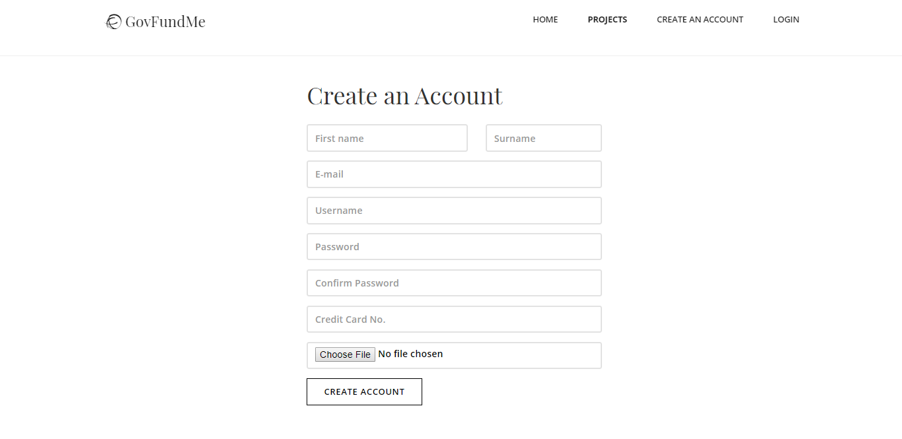
Create an Account

Slide 7
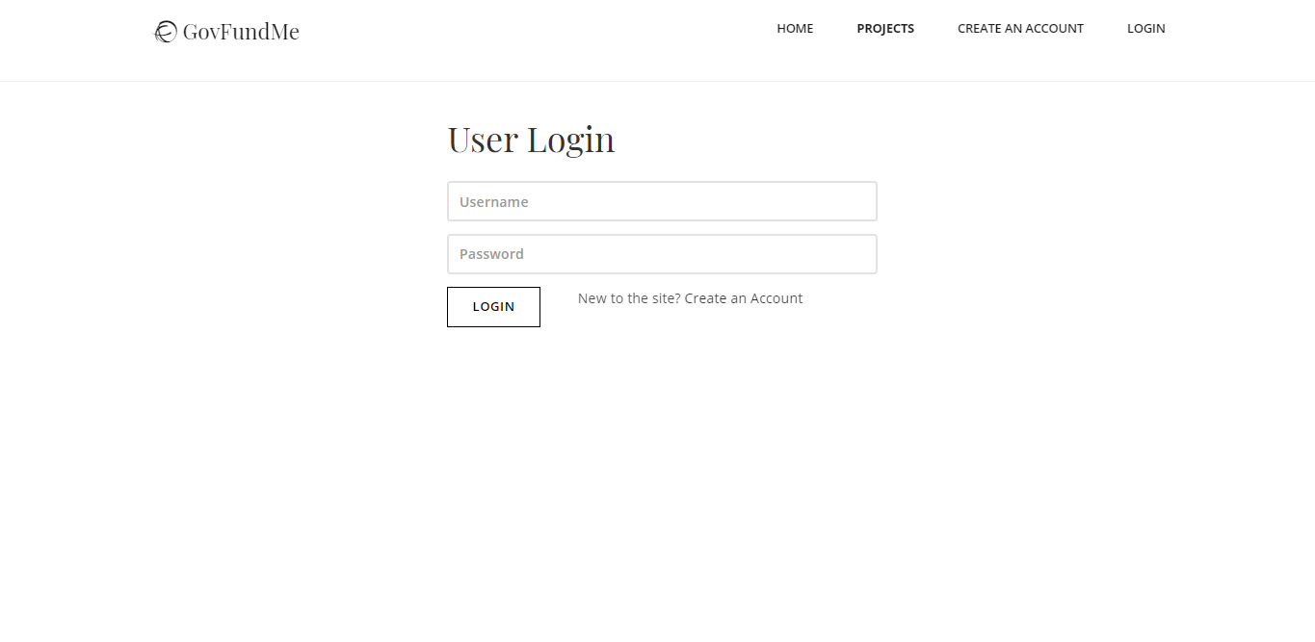
Log in

Slide 8
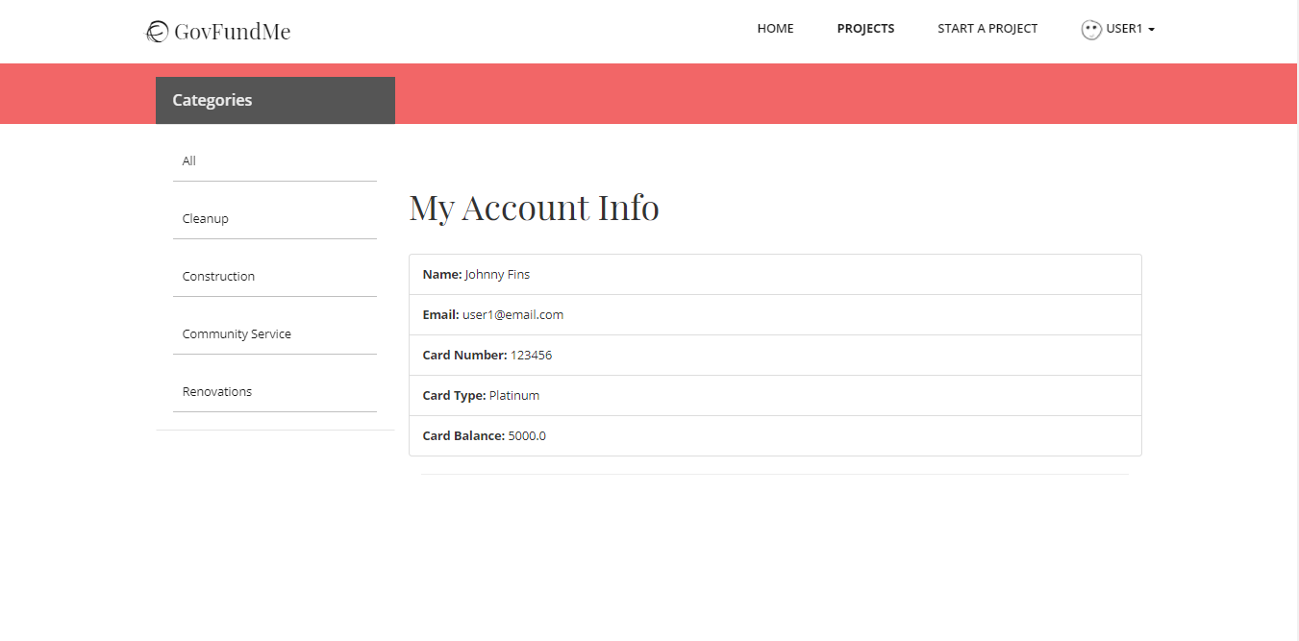
View Account Info

Slide 9
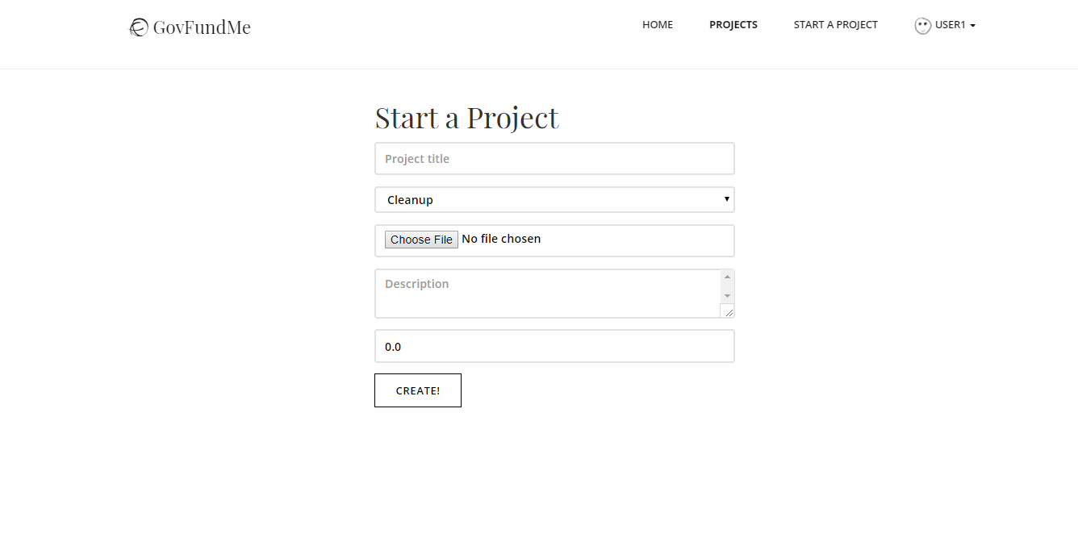
Create a Project

Slide 10
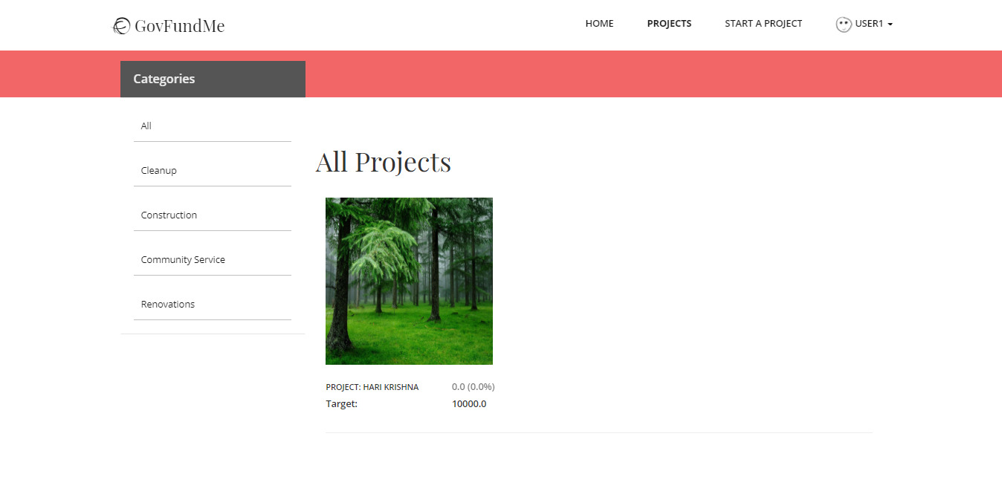
View All Projects and by Its Category

Slide 11
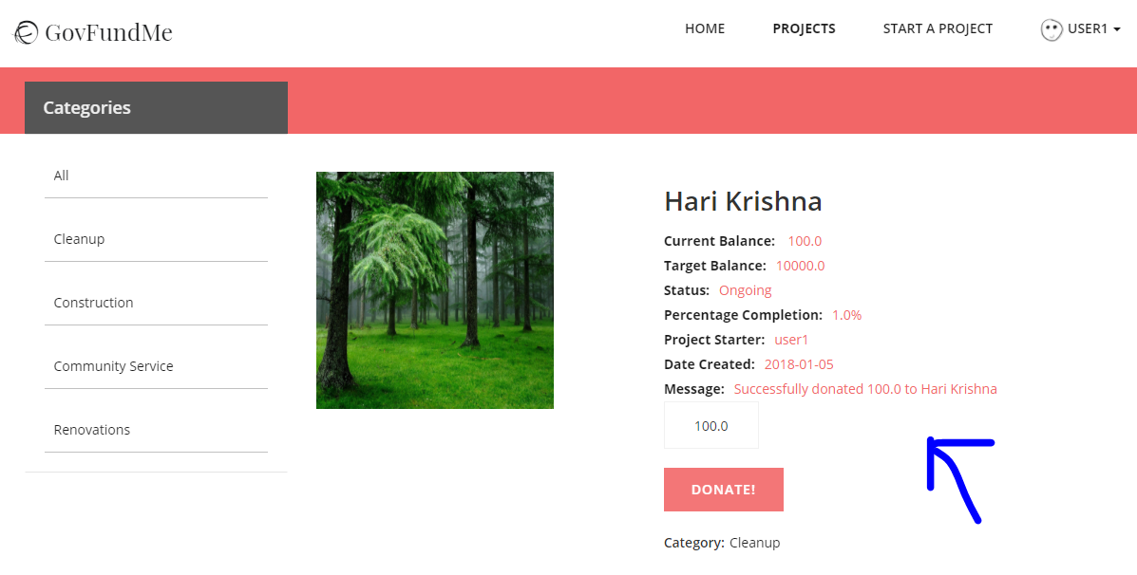
Donate to a Project

